Slide 1
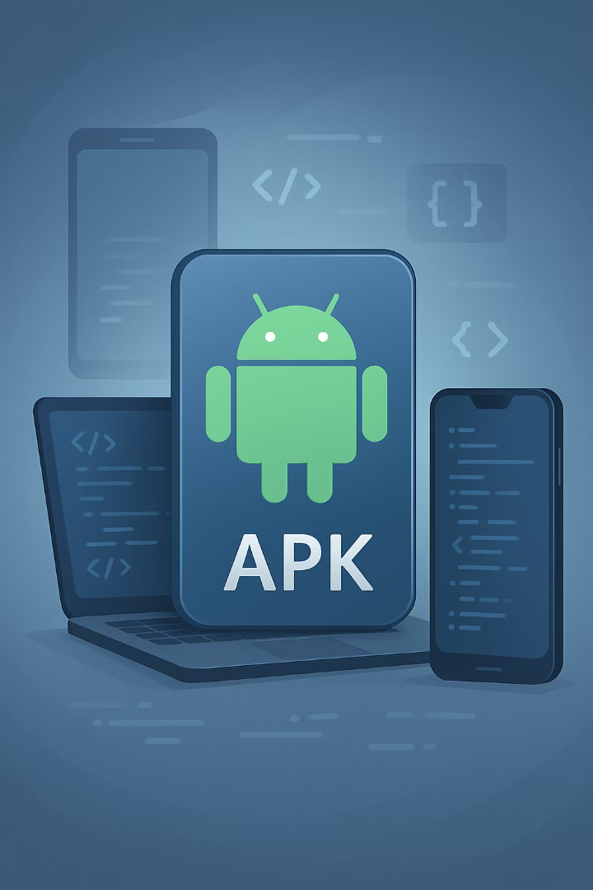

Creating Android APK Files
Learn how to define APK files, understand their importance, create APKs without Android Studio, and test your applications on Android phones.

Slide 2
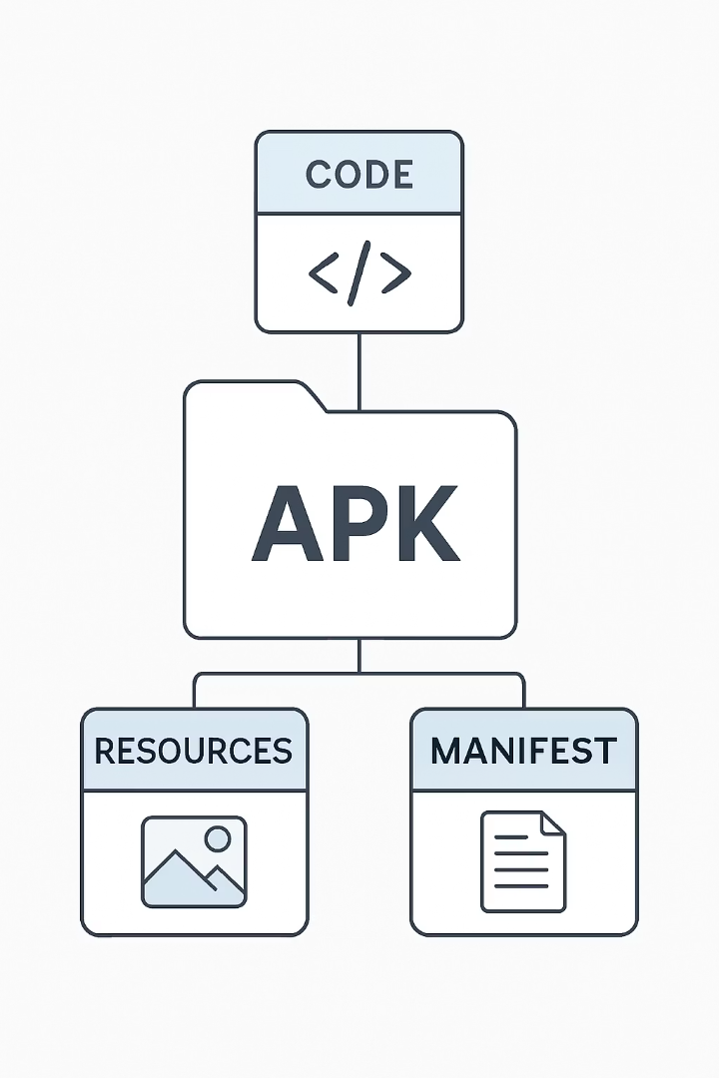
What is an APK File?
Definition
Components
Android Package Kit (APK) is the package format used by Android for distributing and installing apps.
Contains app code, resources, assets, certificates, and manifest files.
Purpose
Essential for deployment and functioning of Android applications.

Slide 3
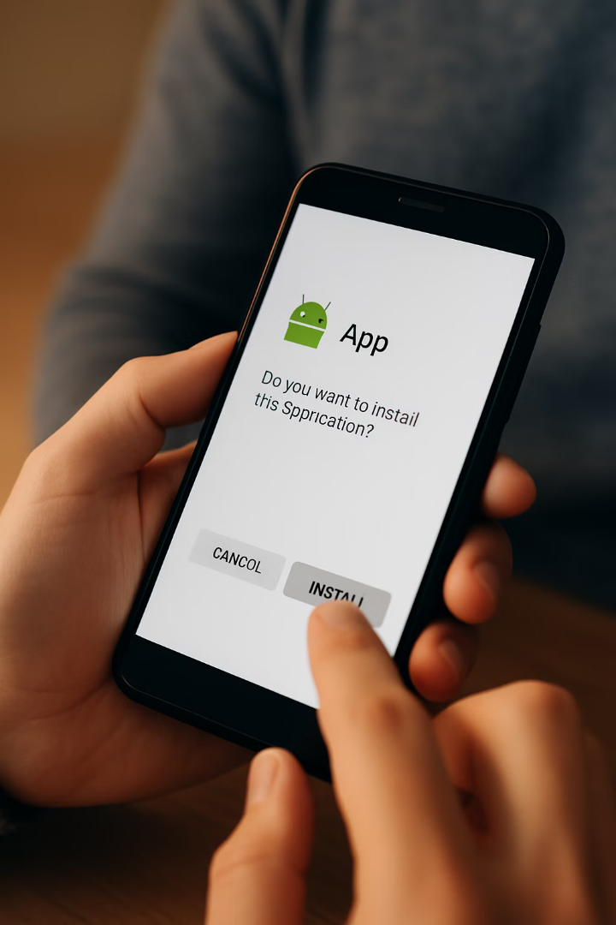




Importance of APK Files
Distribution
Primary way Android apps are distributed and installed on devices.
Bundling
Ensures all resources and code are bundled together for easy installation.
Compatibility
Makes apps run on any compatible Android device.
Customization
Can be modified for specific device or user preferences.

Slide 4
Introduction to EAS Build
What is EAS Build?
Key Benefits
Expo Application Services (EAS) Build is a service provided by Expo that simplifies building and deploying React Native applications.
Cloud-based building process
No complex local environment setup
Leverages Expo's infrastructure

Slide 5




Prerequisites for EAS Build
Expo Account
React Native Project
Internet Connection
Create an account on expo.dev before starting.
Have your React Native project ready for building.
Stable connection for cloud-based building process.

Slide 6
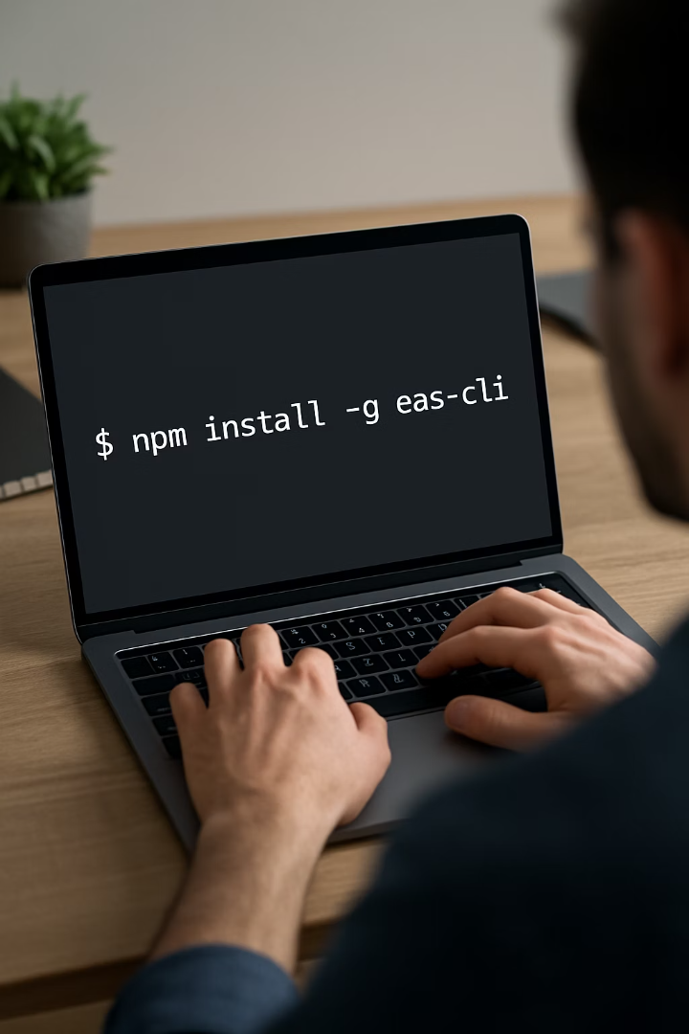
Step 1: Install EAS CLI
Open Terminal
Access command line interface on your computer.
Run Installation Command
For Windows: npm install -g eas-cli
Alternative Command
For Linux/Mac: sudo npm install -g eas-cli

Slide 7
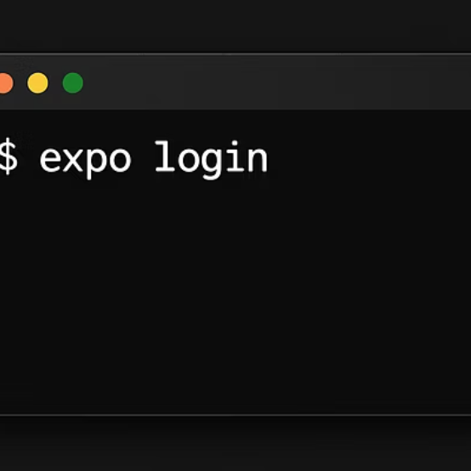
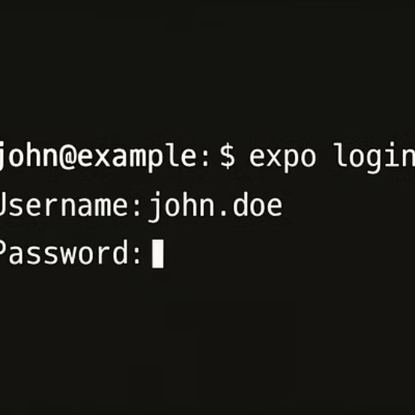
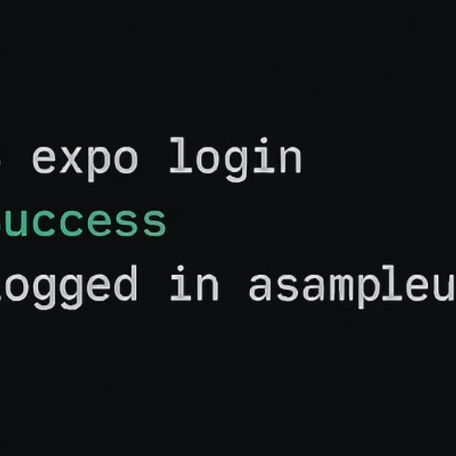
Step 2: Log into Expo Account
Use the command "eas login" in your terminal. Enter your Expo account username and password when prompted. You'll see a "logged in" message upon successful authentication.

Slide 8





Step 3: Configure EAS for Your Project
Run Command
Initialize EAS with "eas build:configure"
Confirm Setup
Press "Y" to configure the project
Select Platform
Choose platform (Android, iOS, or all)
Create Config
EAS creates eas.json configuration file

Slide 9



Step 4: Build the APK
Run build command
eas build -p android --profile preview
Verify app details
Confirm Android application ID
Generate keystore
Press "Y" to create new Android keystore

Slide 10





Building Process
Wait for Build
The build process may take several minutes to complete.
Cloud Processing
EAS handles compilation in Expo's cloud infrastructure.
QR Code Generation
System creates QR code and link to access APK.
APK Available
Final APK is ready for download and installation.

Slide 11

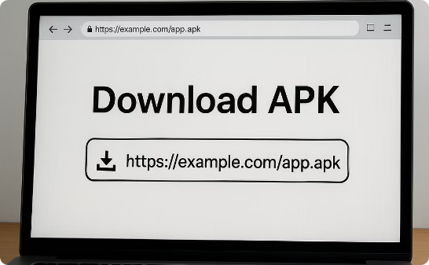
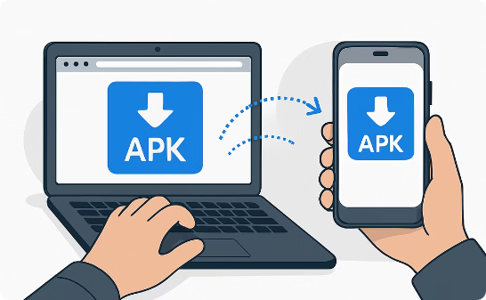
Accessing Your APK
Scan QR Code
Use Direct Link
Share with Device
Use your Android device to scan the generated QR code.
Click or share the provided link to access the APK.
Send the link to your Android phone for installation.

Slide 12
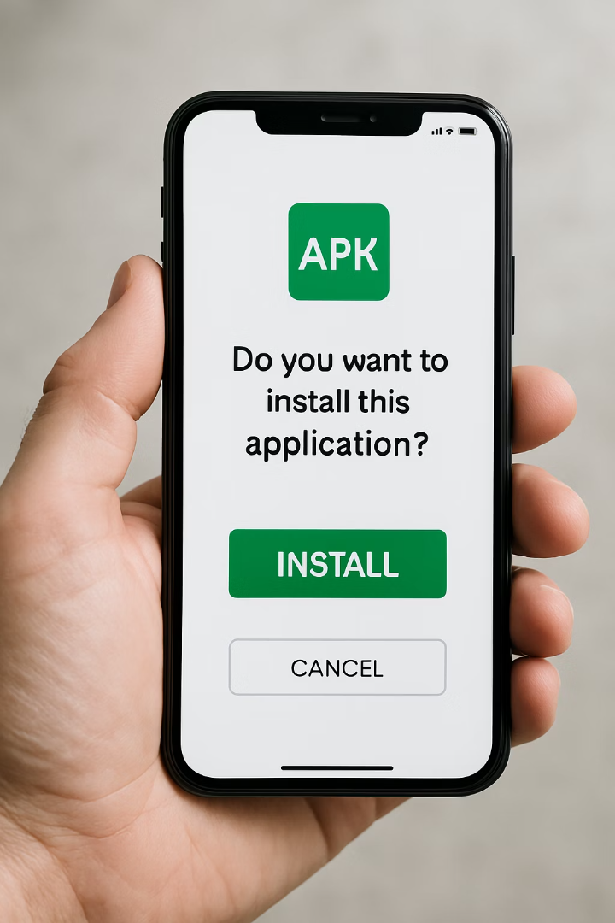




Installing the APK on Android
Open Link
Click the shared link on your Android device.
Install Button
Tap "Install" on the download screen.
Grant Permissions
Allow installation from this source if prompted.
Complete Setup
Open the app after installation finishes.

Slide 13






Key Considerations for APK Creation
Use EAS Build
Recommended for Expo projects with newer Node.js versions
Cloud-Based Process
No local Android folder needed
Configure Settings
Set package name and version code during build

Slide 14





Benefits of EAS Build
Cloud Infrastructure
Leverages Expo's servers for building, eliminating local setup complexity.
Consistency
Ensures consistent builds across different developer environments.
Efficiency
Streamlines the build process for faster development cycles.
Simplicity
Reduces technical barriers for developers new to mobile app building.

Slide 15

Customizing Your Build
EAS.json Profiles
App Versioning
Build Parameters
Create custom build profiles in eas.json for different build configurations.
Set version codes and names to manage app updates properly.
Configure specific Android settings like targetSdkVersion and permissions.

Slide 16








Testing Your APK
Device Compatibility
Performance
Test on various Android versions and screen sizes.
Check app speed and responsiveness on real devices.
User Experience
Bug Detection
Evaluate the app from an end-user perspective.
Identify and fix issues before public release.

Slide 17
Distribution Options
Google Play Store
Direct APK Distribution
Alternative Stores
Official Android app marketplace with the widest reach.
Share APK files directly with users.
Third-party app marketplaces for Android.
No approval process required
Requires developer account
Immediate availability
Amazon Appstore
Provides analytics and crash reporting
Users must enable "Unknown sources"
Samsung Galaxy Store
Huawei AppGallery
Handles updates automatically

Slide 18

Key Takeaways
1
2
APK Definition
EAS Build
Android Package Kit used for distributing and installing Android apps.
Cloud-based service that simplifies React Native app building.
3
4
No Local Setup
Testing
Build process handled in Expo's cloud infrastructure.
APKs enable testing on physical devices before public release.

